Slide 1
Shakespeare
&
The four humors
Hannah Bennett

Slide 2
History & background

Slide 3
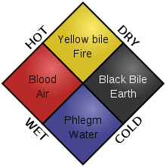
The Humors and Medicine
Hippocrates (kind of)
  Where did this come from?
  How do I get humors?
Elements and Opposites
  Hot vs. Cold
  Moist vs. Dry

Slide 4
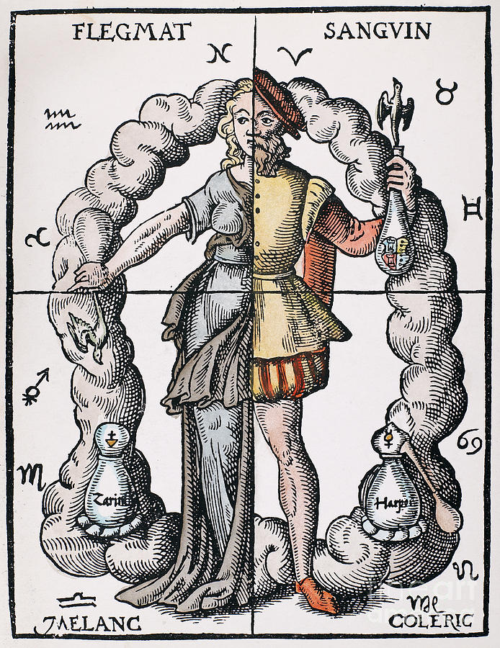
Effects of Humors
What’s a “normal” balance?
Maintaining YOUR Balance
  What does my balance mean?
What if I get imbalanced?
Woodcut from Leonhard Thurneysser’s
'Quinta Essentia,' Leipzig, 1574

Slide 5
The humors
“Then should you be nothing but musical,
for you are altogether governed by humors.”
Lady Percy, I King Henry IV

Slide 6
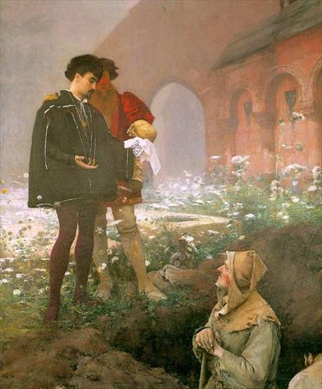
Melancholic
Thoughtful, sadly pensive, neurotic
Black Bile in the spleen
Associated with middle age
“Cold and dry”
Typically artist types
Hamlet and the Gravediggers
Pascal Adolphe Jean Dagnan-Bouveret
(1852-1929)

Slide 7
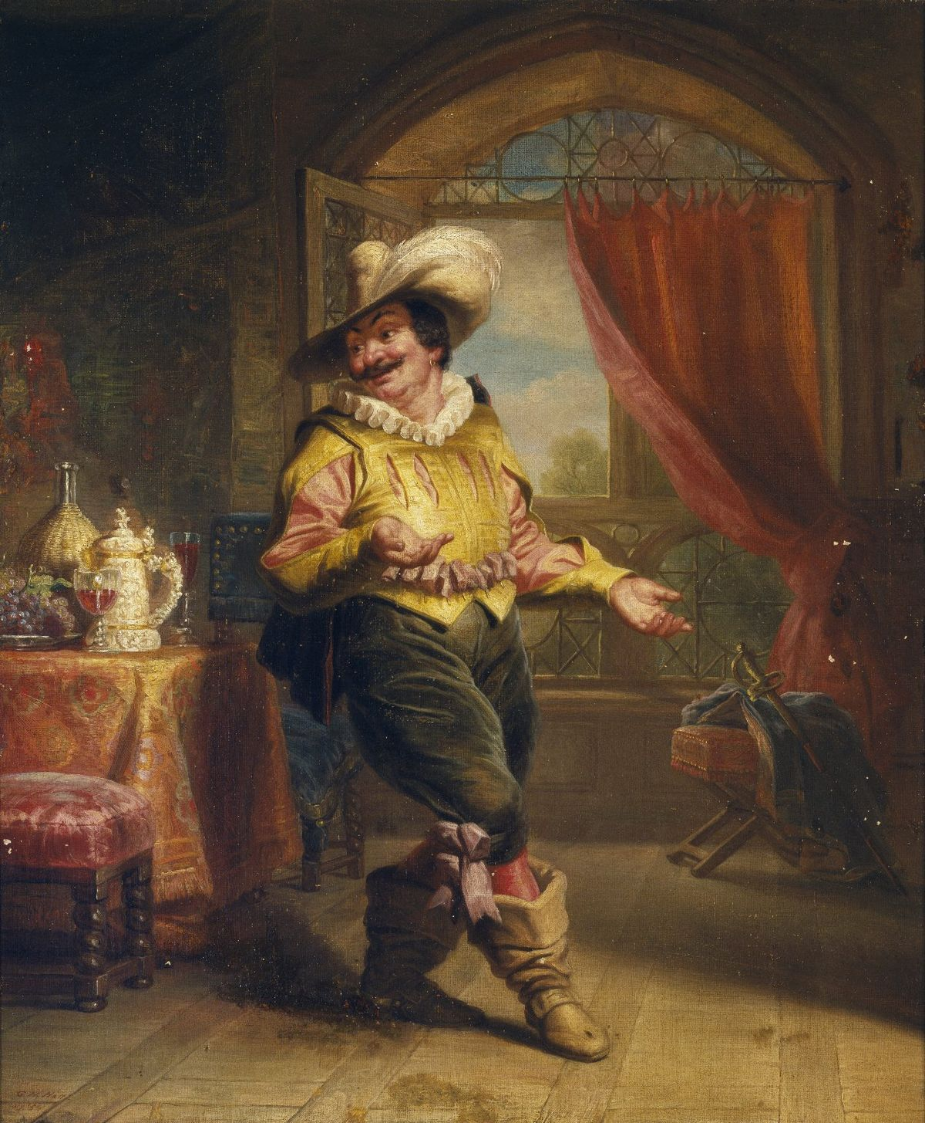
Phlegmatic
Typically apathetic, submissive, idle
Phlegm in the brain or lungs
Associated with the elderly
“Cold and moist”
Often depicted as comic relief in Shakespeare
Sir Toby Belch George Henry Hall (1853)

Slide 8
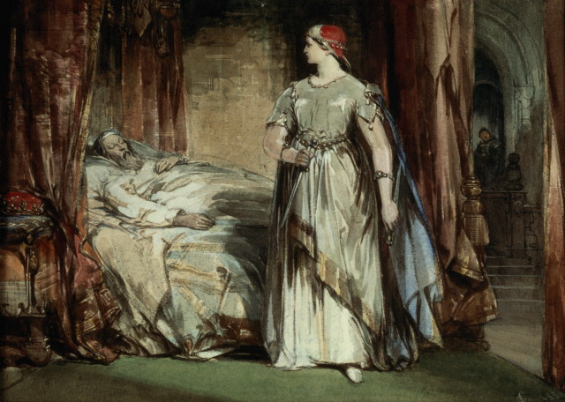
Choleric
Energetic, irritable
  Shoot first ask questions later
Yellow bile in the gallbladder
Associated with adulthood
“Hot and dry”
Often villains or rivals
Lady Macbeth George Cattermole (1850)

Slide 9
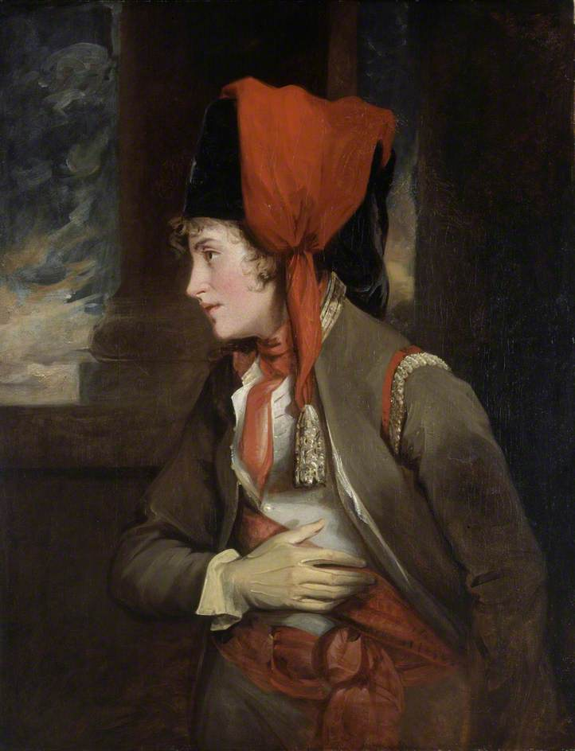
Sanguine
Optimistic and passionate
  “The best one”
Blood and the heart
Associated with adolescence
“Hot and moist”
Often very likable characters
Mrs. Jordan as Viola in ‘Twelfth Night”
John Hoppner (1785-1792)

